Slide 1

Digital portfolio
Student name: S.Keerthana
Register no and NMID: 24131211802522034
Department: B.Sc Computer science
College: Immaculate college for women

Slide 2
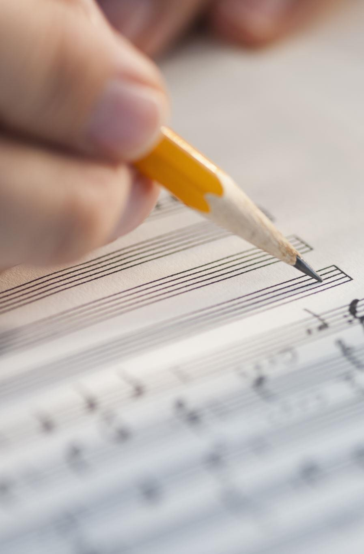
My skills
Write and read
Leaning music

Slide 3
Problem statement
Project Overview
End Users
Tools and Technologies
Agenda
Portofolio design and Layout
Features and Functionality
Result and screenshots Conclusion
Github link

Slide 4
In the digital era having an online Portofolio is essential for showcaseing personal and professional details
Problem statement
Traditional resume are statics while a Portofolio website provides an Interactive way to highlight bio data, education, skills, and Project
The problem is that many students and job seeker to not have a simple, structure and visually appeating digital portfolio to present themselves.

Slide 5
The web page will contain the individual ‘s bio data, skills, Hobbies, education, and personal information in a structure table format
The project aims to design and develop a person Portofolio web page using HTML and CSS.
Project Overview
A profile picture and simple Layout enhance the professional look

Slide 6


Student-to showcase their academic details and Skill
Job seeker-to present resumes digitally
to employee
End Users
Freelancers-to demonstrate Skill and
personal branding
Professional-to maintain an online presence

Slide 7
HTML-for creating the
structure of the portfolio
Tools and Technologies
CSS 3-for styling and Layout
design
Web browser-for testing
(choose, edge, firebox)

Slide 8
Header section-title and portfolio
Picture
Portfolio Design and Layout
Table sections- bio data including name,dob,email, phone, address, education, skills and hobbies
Responsive- adjustabe for
desktop and mobile screen

Slide 9


DISPLAY PERSONAL BIO DATA IN A CLEAR TABLE FORMAT
PROFILE PICTURE AT THE TOP
Features and Functionality
RESPONSIVE AND USER-FRIENDLY DESIGN
SINPLE STRUCTURE FOR EASY CUSTOMIZATION

Slide 10
Result and screenshots
HOME PAGE WITH PROFILE PICTURE AND TITLE
BIO DATA TABLE WITH DETAILS (NAME,EDUCATION, SKILLS, ETC)

Slide 11
Conclusion
It serves as a digital Identify for students and professional, making it easier to share information with Recruiters, institutions or client
This project demonstrate how to create a simple yet effective portofolio web page using basic web technologies (HTML &CSS)

Slide 12
Github link
Htto://github.com/username/p ortfolio-bio data

